Slide 1


Bitcoin Stock Price Prediction using LSTM
Explore the power of Long Short-Term Memory (LSTM) neural networks to forecast the future prices of the leading cryptocurrency, Bitcoin. By analyzing historical close prices and dates, this comprehensive analysis aims to provide valuable insights into the crypto market.
by Alfred

Slide 2

Introduction to Bitcoin and Cryptocurrencies
1
Decentralized Digital Currency
2
Blockchain Technology
Bitcoin is a revolutionary, peer-to-peer digital currency that operates without a central authority.
The underlying blockchain technology securely records and verifies all Bitcoin transactions in a distributed ledger.
3
Volatile Market
The cryptocurrency market is highly volatile, making it both exciting and risky for investors.

Slide 3

Table of Content
1
Agenda
2
Understanding the feature
3
Methodology
4
Key Understanding
5
Business Plan Benifits

Slide 4



Agenda
Financial implications
Market strategy and investment planning
Risk management
Understanding price trends can help investors make informed decisions about buying, selling, or holding Bitcoin.
By anticipating potential price drops, investors can implement risk mitigation strategies to protect their investments.
Predicting price movements can aid in developing effective investment strategies and planning for future market fluctuations.

Slide 5

Understanding the Feature
The dataset has around 7 columns and 2713 rows of data. Understanding each feature is so important to get good model accuracy.
Here in share price dataset all the column give an information and elevate the performance
All the column are of string datatype we want to convert Data column to data format

Slide 6
Methodology
Data Collection and Preprocessing Data Source: Historical Bitcoin data (including columns such as Open, Close, High, Low, Volume). Data Cleaning: Remove unnecessary columns like "Date" for modeling. Handle missing values or NaN entries. Feature Selection: Focus on relevant features: Close, Open, High, Low, and Volume for prediction. Normalization: Apply Min-Max Scaling to normalize features (scaling values between 0 and 1) to improve model convergence and performance.
Data Splitting Train-Test Split: Split the dataset into 60% for training and 40% for testing. The training data is used to train the LSTM model, and the test data is used for evaluating its performance.
Sequence Data Preparation Windowing: Convert the data into time series sequences for the LSTM model. For example, using a time_step of 15, each sequence contains 15 time steps, and the target is the next price in the sequence. Reshaping: Reshape the data into the appropriate format: [samples, time steps, features], which is required by LSTM networks.

Slide 7




Training and Evaluating the LSTM Model
Training:
Fit the model to the training data with a chosen number of epochs
Use validation data to monitor the model’s performance during training to avoid overfitting.
Validation
Continuously evaluate the model's performance on a held-out validation set during training.
Testing
Assess the final model's effectiveness on unseen test data to ensure reliable performance.

Slide 8
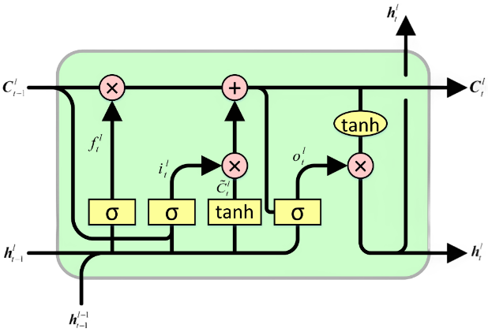
LSTM Model Architecture
Cell State:
The heart of the LSTM, it's like a conveyor belt, carrying information along the sequence.
It can selectively remember or forget information over long periods.
Gates:
Forget Gate: Decides what information to discard from the cell state.
Input Gate: Determines what new information to store in the cell state.
Output Gate: Controls which parts of the cell state are relevant to the current output.

Slide 9
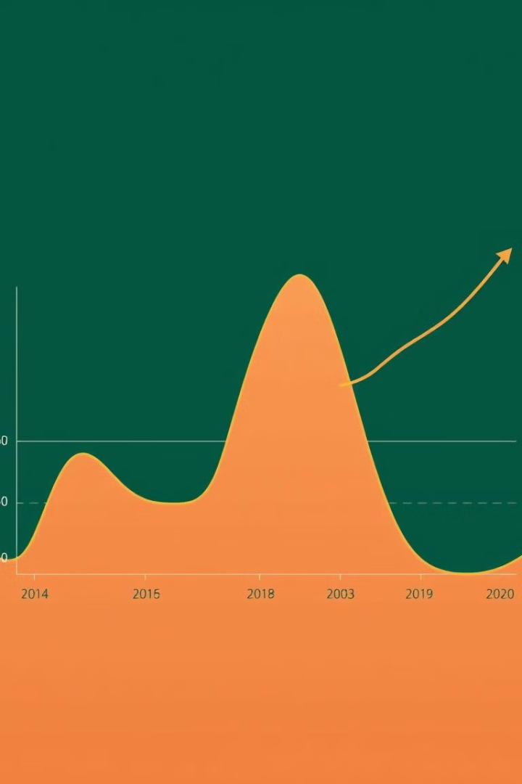

Key Understanding
Convert the data into matrix with time steps:
Capturing Temporal Dependencies:
LSTMs are adept at learning long-term dependencies within a sequence. By structuring data into time steps, you enable the model to recognize patterns and trends that occur over multiple time points.
For example, in a stock price prediction task, the current price might be influenced by past price movements, trading volumes, and other relevant factors.
Efficient Processing:
Matrix-based representation allows for efficient processing by deep learning frameworks.
Many optimization techniques and parallel processing capabilities are designed to work with matrix operations, making training and inference more efficient.
Compatibility with LSTM Architecture:
LSTMs are designed to process sequences of fixed-length inputs. By converting data into a matrix with a specific number of time steps, you ensure that the input format aligns with the LSTM's expectations.

Slide 10
Key Understanding
Convert the data into matrix with time steps.
1
2
Reshape the input for LSTM (samples, time steps, features).
Reshape the input for LSTM (samples, time steps, features):
By reshaping your input data into the format (samples, time steps, features), you're essentially providing the LSTM with a structured representation of the sequence that it can effectively process.

Slide 11
Breaking Down the Dimensions:
Samples:
This dimension represents the number of independent sequences or samples in your dataset.
Each sample is treated as a separate instance to be processed by the LSTM.
Time Steps:
This dimension defines the length of each sequence or the number of time steps within a sample.
It determines how many past observations the LSTM considers when making predictions.
Features:
This dimension specifies the number of features or variables associated with each time step.
For example, in a time series forecasting problem, each time step might have features like temperature, humidity, and wind speed.

Slide 12

Conclusion and Future Considerations
1
Key Takeaways
2
Limitations and Improvements
The achieved accuracy is an approximation and may not be exact.
The accuracy is derived from a specific methodology and may be influenced by various factors, leading to potential inaccuracies.
The accuracy, while achieved, is subject to inherent limitations and may not be perfectly precise.
3
Real-World Applications
LSTM model could be leveraged by investors, traders, or other stakeholders. When combined with technical indicators like RSI, Moving Average can make an significantly enhance time series forecasting accuracy

